Slide 1

An Accessible Open-Source Implementation of the Congruent Matching Cells Algorithms for Cartridge Case Analysis
11:05-11:20 D38
Joseph Zemmels, Susan VanderPlas, Heike Hofmann

Slide 2
Overview
Cartridge case analysis
Algorithms & open-source code
The Congruent Matching Cells pipeline
The cmcR package
CMC pipeline experimentation

Slide 3
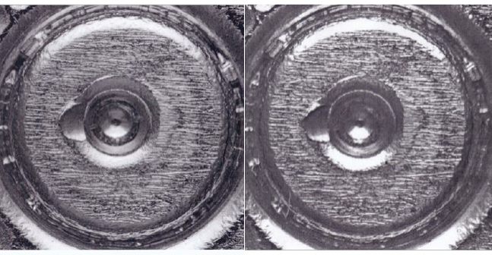
Cartridge Case Analysis

Slide 4
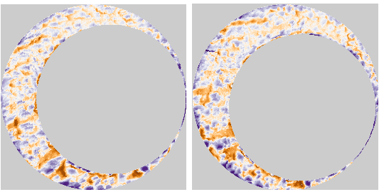
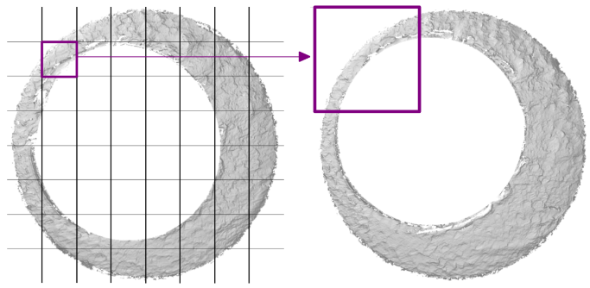
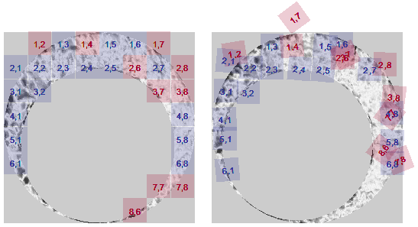
Algorithms as Data-to-Results Pipelines
Algorithm: A set of instructions used to perform a computation.
Can be used to measure the similarity between evidence.
Initial Data
Pre-processing
Comparison
Final Results

Slide 5
What are Open-Source Algorithms?
Code is freely available for investigation and experimentation

Slide 6
Open-Source and Reproducibility
Reproducibility
“Obtaining consistent computational results using the same input data, computational steps, methods, code, and conditions of analysis.” (NASEM, 2019)
Hierarchy of Reproducibility
Conceptual description
Pseudocode
Reproducible data
Comparable results
Full reproducibility

Slide 7
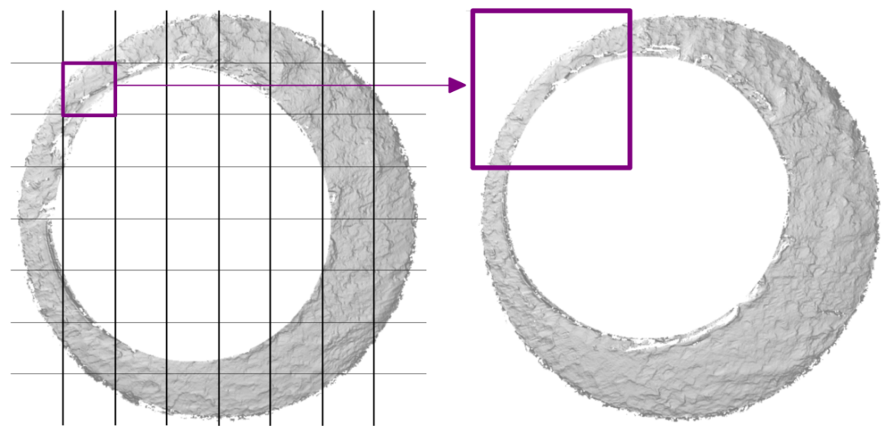
The CMC Pipeline
Developed at NIST in 2013
Measure similarity between cartridge cases

Slide 8
The cmcR package
Created using the R statistical programming language
Available for free on the Comprehensive R Archive Network

Slide 9
cmcR Pipeline
[Some sort of diagram showing something like:
Starting data %>%
Preprocessing step %>%
Processing step %>%
Final results
Emphasizing the pipe operator as the connection between steps
Maybe have conceptual pipeline on the left-hand side and actual code on the right hand-side, both connecting broad stages to each other with the pipe operator]

Slide 10
CMC Algorithm Experimentation

Slide 11
Resources
cmcR Source Code: https://github.com/CSAFE-ISU/cmcR
NIST Database: https://tsapps.nist.gov/NRBTD/Studies/Search
Intro to R resources

Slide 12
References

